Slide 1
Advanced Data Architecture and Engineering Principles

Slide 2
Data
Data is the fundamental resource that drives all activities in data engineering and the data science life cycle.
Its importance is paramount because high-quality, reliable, and accessible data is essential for enabling data-driven decision-making, generating meaningful insights, and ensuring the success and accuracy of analytical models.

Slide 3
Data Engineering
Data Engineers are the architects and builders of the data infrastructure
Their primary focus is ensuring data is available, reliable, and accessible for others to use.
They build the "data pipelines" that ingest, transform, and store data from various sources into data warehouses, data lakes, or databases.

Slide 4
Focus Area | Key Responsibilities | Core Skills/Tools
Data Infrastructure | Designing and building robust ETL/ELT pipelines; managing databases and data warehouses; ensuring data quality, security, and accessibility. | SQL, Python, Scala, Spark, Hadoop, Kafka, Airflow, AWS/Azure/GCP, Data Warehousing (e.g., Snowflake, Redshift).
The "Who" | Data engineers provide reliable data for Data Analysts, Machine Learning Engineers, and other business stakeholders.

Slide 5
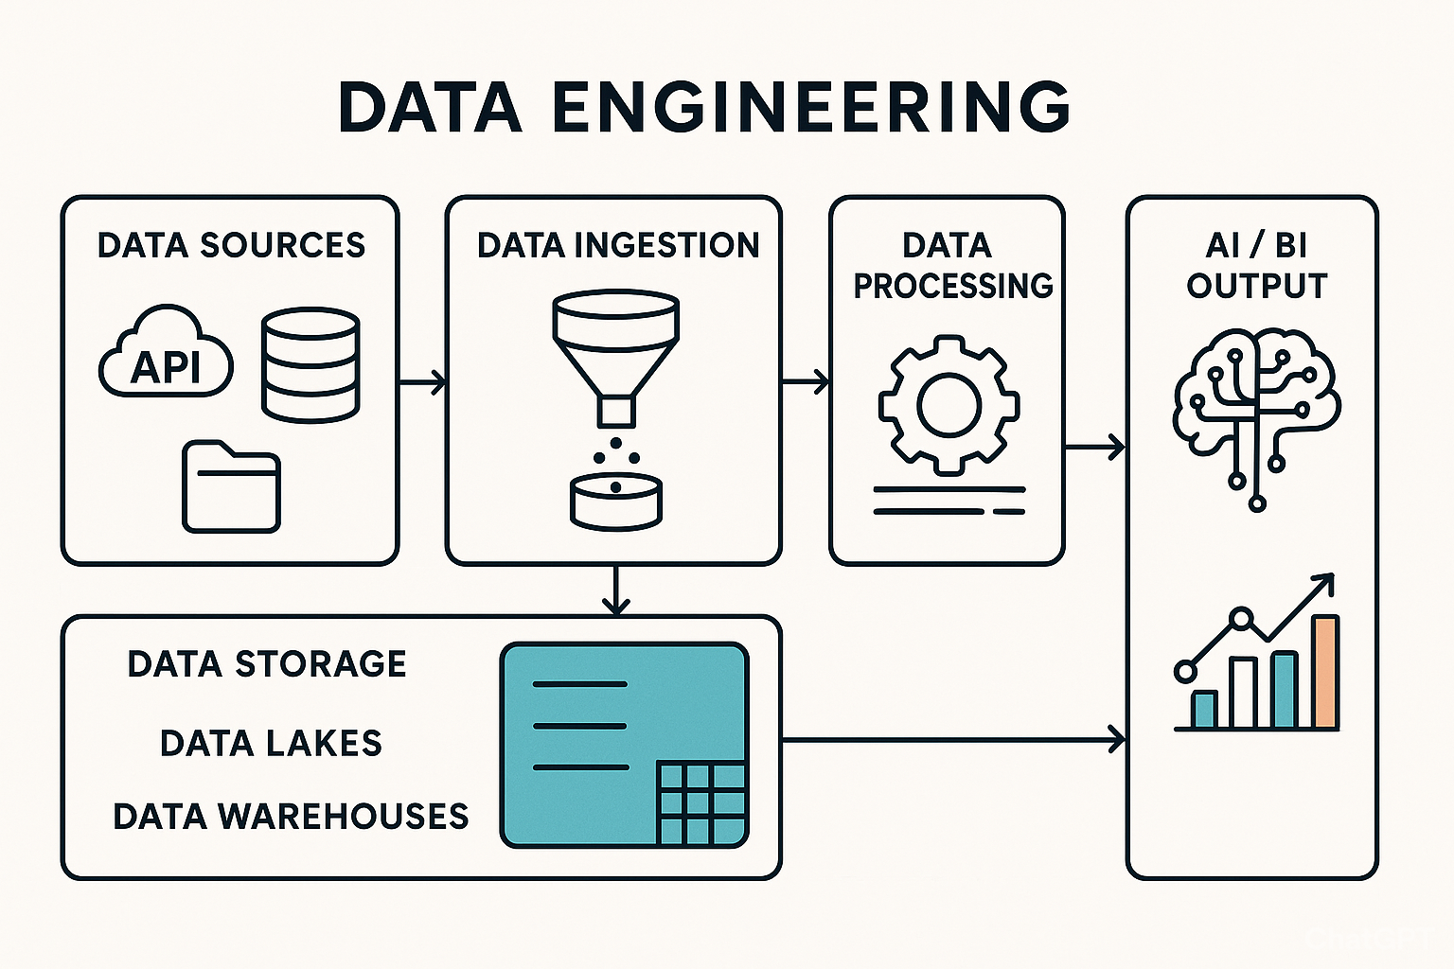

Slide 6
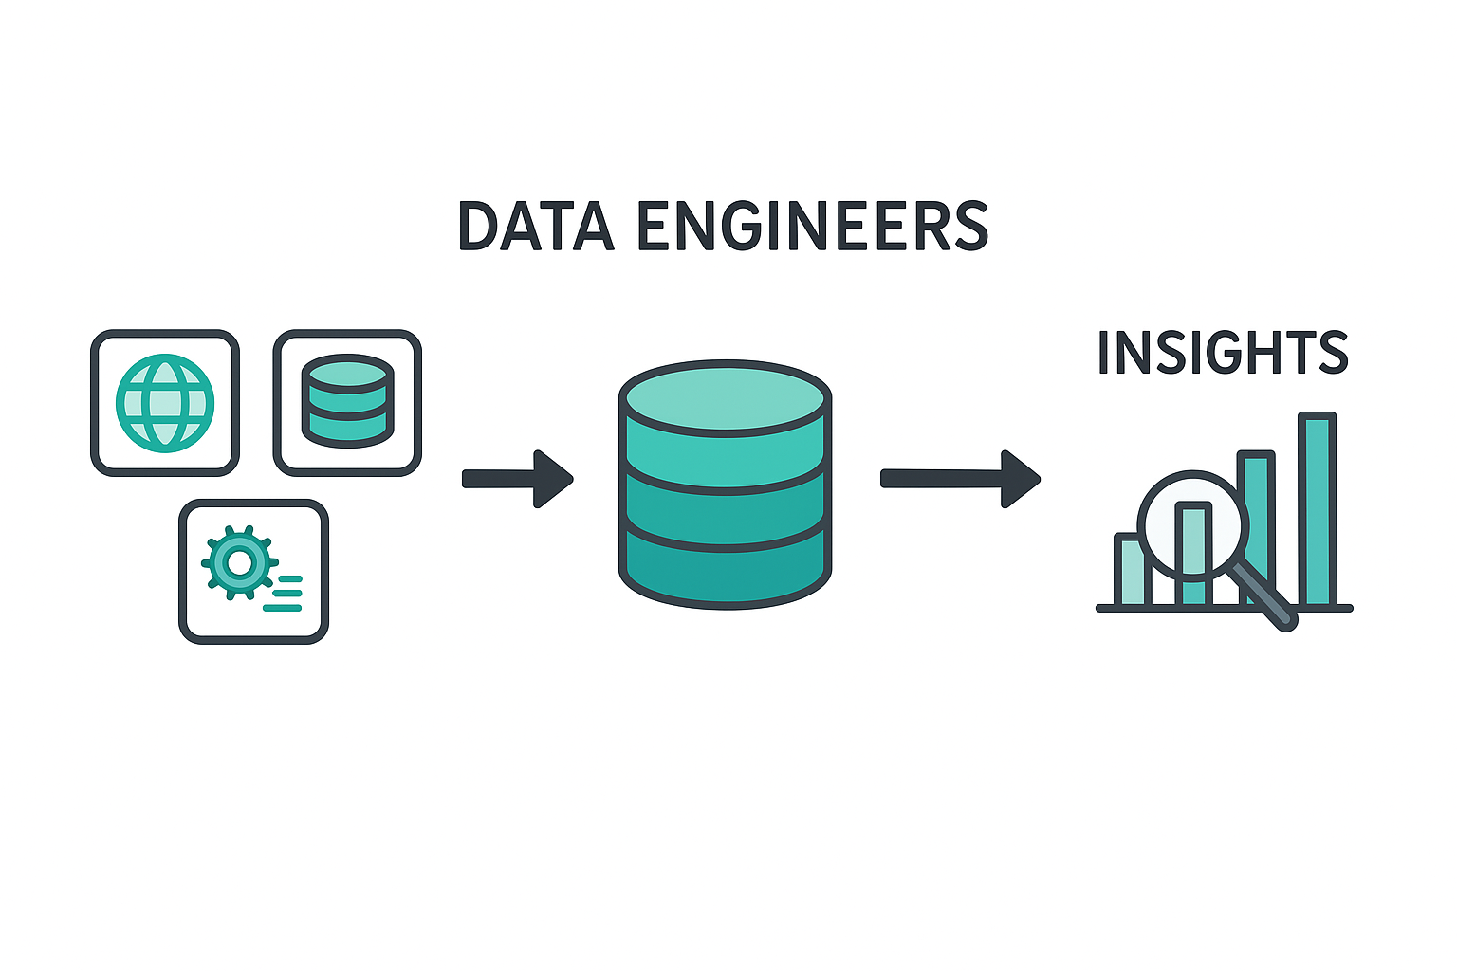

Slide 7
Overview of Data Engineering vs. Data Science
Data Engineering
Build and maintain the data infrastructure and pipelines that make data accessible, reliable, and usable for analysis and machine learning.

Slide 8
Data Engineering
Skills Required:
Strong programming (Python, Java, Scala).
Data modeling & architecture.
SQL expertise.
ETL/ELT design.
Cloud platforms (AWS, Azure, GCP).
Big Data technologies (Hadoop, Spark, Kafka).
Common Tools:
Airflow, dbt (Data Build Tool)
Apache Spark, Kafka, Flink
SQL/NoSQL databases (PostgreSQL, MongoDB, Cassandra)
Data warehouses (Snowflake, Redshift, BigQuery)
CI/CD, Docker, Terraform

Slide 9
[Web App Logs]
↓
[Kafka Stream]
↓
[Spark Streaming for cleaning & aggregation]
↓
[Load into Snowflake Data Warehouse]
↓
[Tableau dashboard / ML Model Training]

Slide 10
Key Components in Data Engineering Architecture
Data Sources
APIs, relational DBs (Oracle, MySQL, PostgreSQL)
Streaming sources (Kafka, IoT devices)
Flat files (CSV, JSON, Parquet)
Data Ingestion Layer
Batch: Apache NiFi, Airbyte, AWS Glue
Streaming: Kafka, Flink, Kinesis
Storage Layer
Data Lakes (for raw data): AWS S3, Azure Data Lake, Hadoop HDFS
Data Warehouses (for structured, analyzed data): Snowflake, BigQuery, Redshift, Oracle 23AI
Transformation Layer
ETL/ELT tools: Apache Spark, dbt, Talend, Informatica
Python or SQL-based scripts
Orchestration Layer
Workflow schedulers: Apache Airflow, Prefect, Luigi
Serving Layer
BI Tools: Power BI, Tableau, Looker
ML Platforms: TensorFlow, PyTorch, Vertex AI

Slide 11
Data Analyst (DA)
Data Analysts are the storytellers of the data world.
Their main goal is to interpret data and communicate findings that help businesses make informed decisions.
They often use the clean data provided by Data Engineers to answer specific business questions, identify trends, and create visualizations.

Slide 12
Focus Area | Key Responsibilities | Core Skills/Tools
Business Insights | Cleaning and preparing data for analysis; creating reports and dashboards; performing ad-hoc analysis; communicating insights to stakeholders. | SQL, Excel, Python/R (for statistical analysis), BI Tools (e.g., Tableau, Power BI, Looker), basic statistics.
The "Who" | Data analysts provide actionable insights to management, marketing, sales, and operations teams.

Slide 13
Machine Learning Engineer / Data Scientist (ML/DS)
The ML professional focuses on using advanced statistics and algorithms to predict future outcomes or automate complex decision-making processes.
They transform raw data into predictive models.

Slide 14
Focus Area | Key Responsibilities | Core Skills/Tools
Predictive Modeling | Defining the ML problem; performing feature engineering; selecting and training ML models; evaluating model performance; prototyping the solution. | Python/R (with libraries like scikit-learn, TensorFlow, PyTorch), statistics, calculus, linear algebra, ML algorithms.
The "Who" | ML professionals create models for MLOps teams to deploy, and their models' outputs can be used by analysts or integrated into products.

Slide 15
Key Responsibilities
Exploratory data analysis and visualization.
Statistical modeling and hypothesis testing.
Machine learning model development and deployment.
Communicate insights to stakeholders.
Collaborate with business and engineering teams.

Slide 16
Data Science
Skills Required:
Python/R for data analysis.
Statistics and probability.
Machine learning and deep learning.
Data visualization (Matplotlib, Seaborn, Plotly).
Knowledge of business domain.
Common Tools:
Jupyter Notebooks, Pandas, NumPy
Scikit-learn, TensorFlow, PyTorch
Tableau, Power BI
SQL for querying data
ML lifecycle tools (MLflow, Weights & Biases)

Slide 17
Key Differences
Aspect | Data Engineering | Data Science
Focus | Data pipelines and infrastructure | Data analysis and modeling
Primary Output | Usable and reliable data | Insights and predictions
Tech Stack | ETL tools, cloud infrastructure, databases | ML libraries, visualization tools
Programming | Python, Java, Scala, SQL | Python, R, SQL
Collaboration | Works closely with engineers & architects | Works with analysts, business, engineers

Slide 18
Data Architecture
Data architecture includes the design and organization of data assets, enabling the management, storage, and use of data within an enterprise.
It creates a blueprint that defines data collection, storage, integration, and usage, ensuring that data can be used for business operations and decision-making processes.

Slide 19
Key principles of modern data architecture
Data Quality
Data Governance
Data Provenance
Data in Context
Granularity of Detail
Data Security

Slide 20
Key Responsibilities
Design, construct, and maintain scalable data pipelines.
Integrate data from multiple sources (APIs, databases, files, etc.).
Ensure data quality, governance, and lineage.
Manage and optimize data storage (e.g., data lakes, warehouses).
Work with batch and real-time data processing.

Slide 21
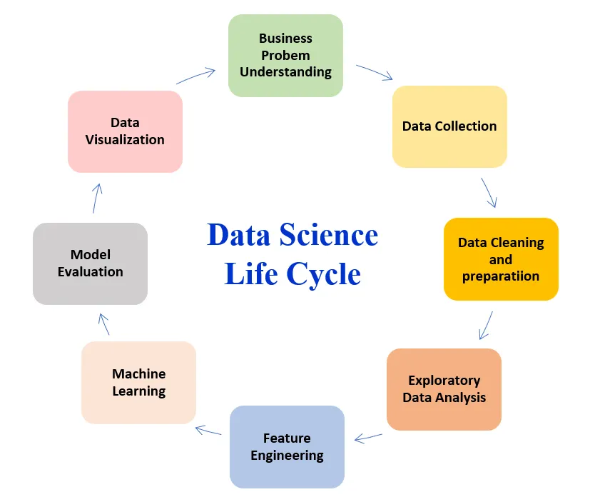
Importance of Data in the Data Science Life Cycle

Slide 22
Data Lake
A Data Lake is a centralized storage system that allows you to store all your data—structured, semi-structured, and unstructured—at any scale.

Slide 23
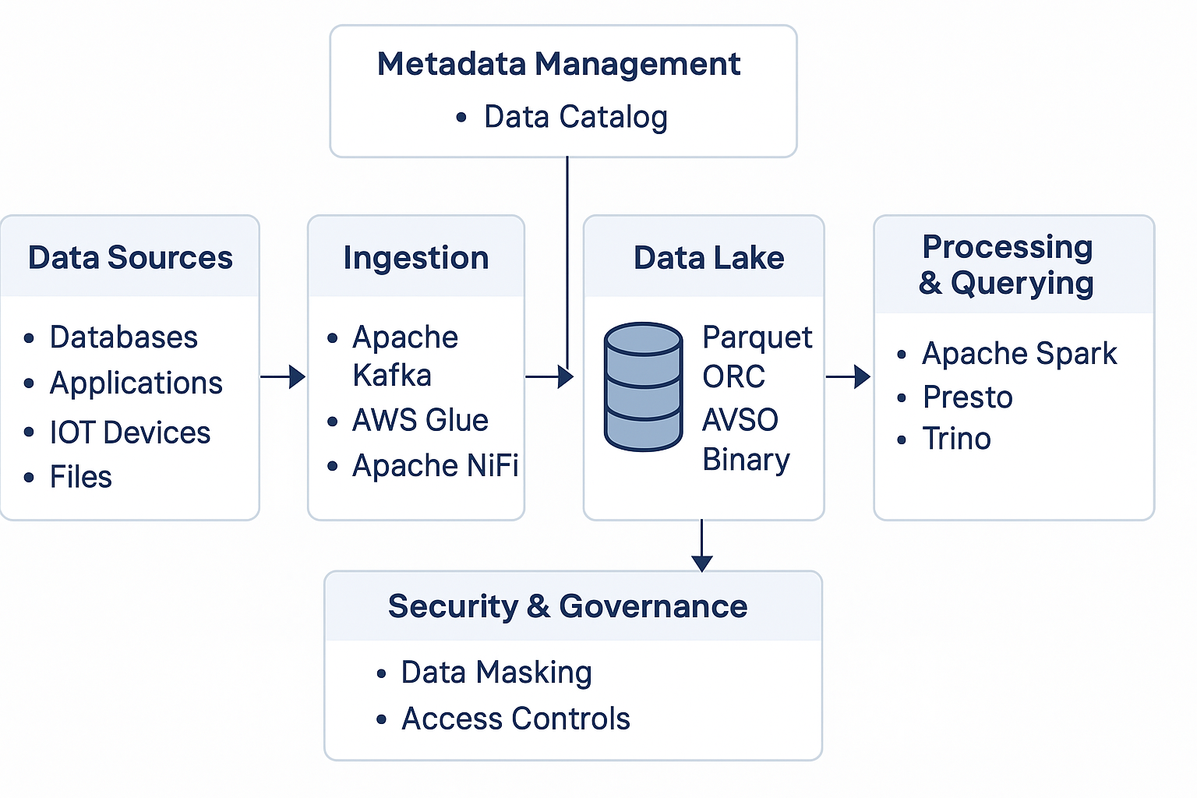
Architecture

Slide 24
Characteristics of a Data Lake
Feature | Description
Stores any data | Raw logs, CSVs, JSON, videos, sensor data, etc.
Schema-on-read | You define the structure when reading, not when storing
Scalable | Grows with your data, supports petabyte scale
Cost-effective | Store cheaply using object storage (e.g., S3, Azure Blob)
Flexible | Good for AI/ML, analytics, reporting, or archiving

Slide 25
Components of a Data Lake
Layer | Role
Storage | S3, HDFS, Azure Blob, GCS
Ingestion | Kafka, Apache NiFi, AWS Glue
Processing | Apache Spark, Flink, dbt, EMR
Cataloging | Hive Metastore, AWS Glue Catalog, Apache Atlas
Querying | Presto, Trino, Athena, Dremio
Security | IAM, lakeFS, encryption, data masking

Slide 26
Advantages of Data Lakes
Data Exploration and Discovery
Scalability
Cost-Effectiveness
Flexibility and Agility
Advanced Analytics

Slide 27
Challenges of Data Lakes
Data Quality
Security Concerns
Metadata Management
Integration Complexity
Skill Requirements

Slide 28
Hands on
Create Delta tables with versioning
Perform schema evolution
Use Time Travel with Delta Lake
Query raw CSV/JSON data using Spark
Do simple ETL: read → transform → write
Partition and optimize datasets

Slide 29
Data Warehouse vs. Data Lake
Features | Data Warehouse | Data Lake
Data Type | Primarily structured data | Structured, semi-structured and unstructured data
Storage Method | Optimized for structured data with predefined schema | Stores data in its raw, unprocessed form
Scalability | Limited scalability due to structured data constraints | Highly scalable, capable of handling massive data volumes
Cost Efficiency | Can be costly for large datasets due to structured storage | Cost-effective due to flexible storage options like object storage
Data Processing Approach | Schema-on-write (data must be structured before ingestion) | Schema-on-read (data is stored in raw form, schema applied during analysis)
Performance | Optimized for fast query performance on structured data | Can be slower due to raw, unprocessed data

Slide 30
Data Mart
A data mart is a specialized subset of a data warehouse focused on a specific functional area or department within an organization.
It’s optimized for fast access and specific analytics needs rather than storing all enterprise data.

Slide 31
Purpose of a Data Mart
Feature | Description
Targeted | For one team/function (sales, HR, etc.)
Fast | Smaller data = faster queries
Simpler | Easier to model & maintain than a full warehouse
Secure | Limits sensitive data access to the right people

Slide 32
Types of Data Marts
Type | Description
Dependent | Built from a central data warehouse (ETL pulls from there)
Independent | Built directly from source systems (no central warehouse)
Hybrid | Mix of both methods

Slide 33
Feature | Data Lake | Data Warehouse | Data Mart
Purpose | Store all data (raw & processed) | Store structured data for analysis | Store department-specific data
Data Types | Structured, semi-structured, unstructured | Mostly structured | Structured
Users | Data scientists, engineers | Business analysts, BI users | Specific departments (e.g., Sales)
Size & Scope | Enterprise-wide, huge scale | Enterprise-wide but curated | Limited to a department or team
Storage Cost | Lower (cheap storage like S3/HDFS) | Higher (optimized for performance) | Lower to moderate
Speed | Slower querying | Fast, optimized queries | Very fast (smaller data sets)
Schema | Schema-on-read | Schema-on-write | Schema-on-write
ETL Process | ELT (transform later) | ETL (transform before loading) | Derived from warehouse or sources
Examples | Amazon S3 + Delta Lake, Hadoop | Amazon Redshift, Snowflake, BigQuery | Sales Mart, Marketing Mart

Slide 34
Real-World Analogy
Data Lake | Like a big raw materials warehouse — store everything from logs to images, no matter the format.
Data Warehouse | Like a refined product inventory — only clean, structured data for analytics.
Data Mart | Like a mini shop inside the warehouse just for one team, like sales or HR.

Slide 35
Apache Iceberg
Apache Iceberg is an open table format for huge analytic datasets.
It's designed to work on data lakes and support features usually found only in databases.

Slide 36
Apache Iceberg
Feature | Description
ACID Transactions | Safe concurrent reads/writes
Time Travel | Query old versions of data
Schema Evolution | Change schema without breaking things
Partition Evolution | Update partition strategy without rewriting data
Hidden Partitioning | Simplifies partitioning logic for users

Slide 37
Apache Kafka
Apache Kafka is a distributed event streaming platform used to:
Ingest real-time data
Process and analyze streams
Build data pipelines and event-driven apps

Slide 38
How Kafka Works
Producer | Sends (publishes) messages to Kafka
Consumer | Reads (subscribes to) messages from Kafka
Topic | Named stream where messages are sent and stored
Partition | A topic is split into partitions to parallelize data
Broker | Kafka server that stores data and serves clients
Cluster | Group of brokers working together
Offset | Position of a message in a partition (like a message ID)

